Slide 1
Parent Meeting Phonics Screening Check
Notes:
Approximately 10 minutes is needed for this session.
Notes are provided to help you lead the presentation.
Notes in italics are for your attention only.
Provide copies of ‘Reading at Home Booklet 2’ from Oxford Owl for each parent.

Slide 2
Reading changes everything
Teach a child to read and keep that child reading and we will change everything.
And I mean everything.
Jeanette Winterson
Notes:
Read quote.
By the end of Year 1, we want all of our children to be able to read accurately – to read both familiar and unfamiliar words - so that they can go on to become a fluent, enthusiastic reader.
The Phonics Screening Check in June in year 1 is a word reading test to check children can read sounds in words accurately.
Accurate word reading at 6 is a predictor of future success.

Slide 3
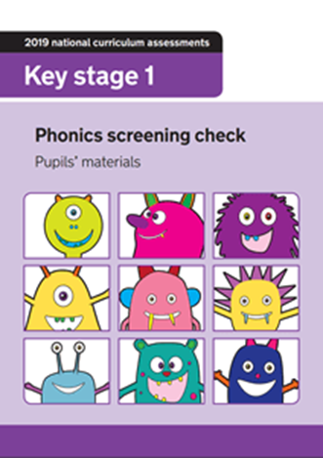
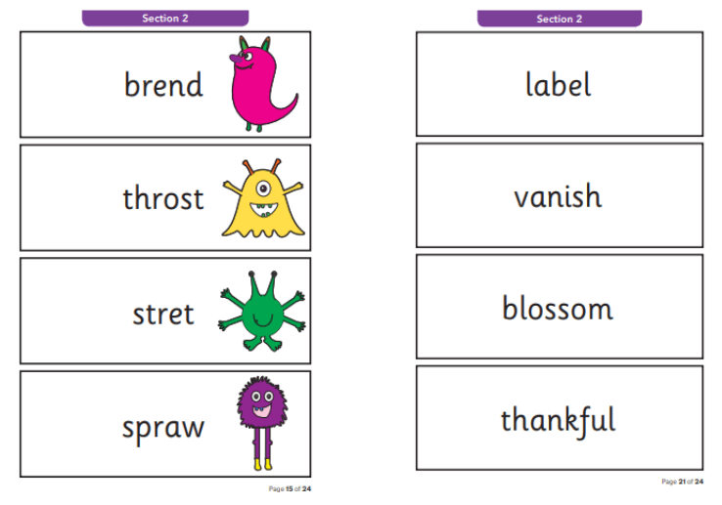
What is the Phonics Screening Check?
A word-reading test at the end of Year 1.
Children read 40 words.
Notes:
Children complete the phonics screening check at the end of Year 1 so that parents can be confident their children are being taught to read successfully.
Children read 40 words. It takes between two and five minutes.
If they do not manage to read 32 of the words successfully, they are given extra support, and repeat the check at the end of Year 2.
It means that all children will be able to read accurately before they begin Year 3.

Slide 4

What does the check look like?

Slide 5
Speed Sounds Set 3
Notes:
Children learn all of the sounds on this chart.
Once they know all of these sounds, they will be able to read any unfamiliar word.

Slide 6

‘Special Friends’, ‘Fred Talk’
Notes:
We teach children to words using the routine ‘Special Friends’, ‘Fred Talk’, read the word’.
Children spot the ‘Special Friends’ (two letters that make one sound), Fred talk the word, and then read the whole word.
For example, ‘sh’, sh-i-p, ship.

Slide 7



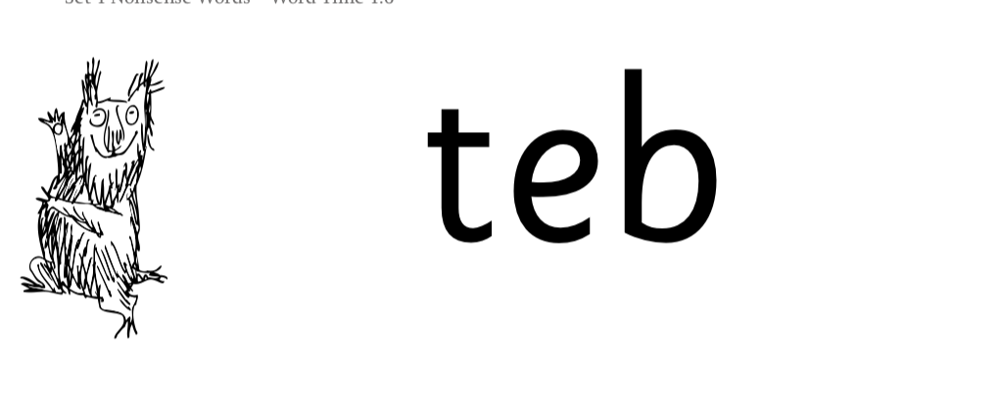
Nonsense words
Notes:
Half of the words in the check are real words.
Half are nonsense words. For example, ‘sheb’, ‘glight’, ‘ched’, ‘teb’.
There is a picture of an alien next to each word to remind the children that it isn’t a real word.
Nonsense words are used to assess children’s reading.
They check that children will be able to read sounds the sounds they know in unfamiliar words.
They read these words using the same routine as real words – ‘Special Friends, Fred Talk.’
Children who can read nonsense words will, very soon, be able to read any new word – for example – gargantuan, flailing, raucous, anticipation;
Reading new words increases children’s vocabulary rapidly.

Slide 8
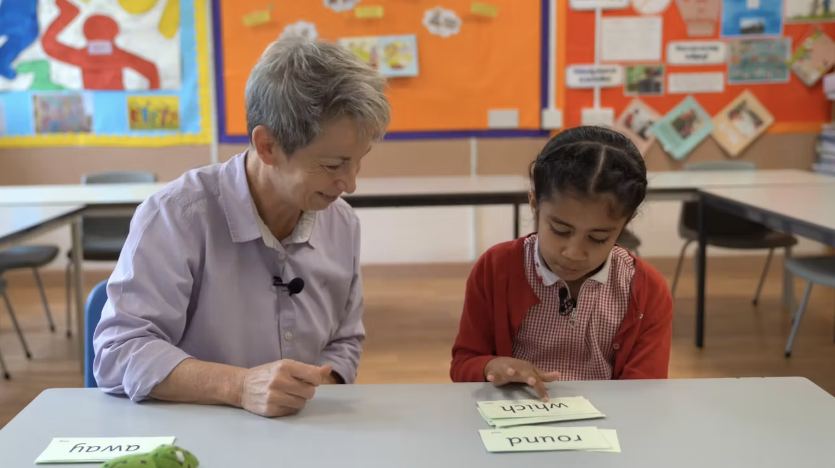
Teach every child to read
Notes:
In our school, we aim to make sure that every child learns to read accurately by the end of Year 1 so they are set up for success in school and in life.
As soon as we spot a child who needs extra practice learning to read sounds and words, we teach them one-to-one for a few minutes every day.

Slide 9
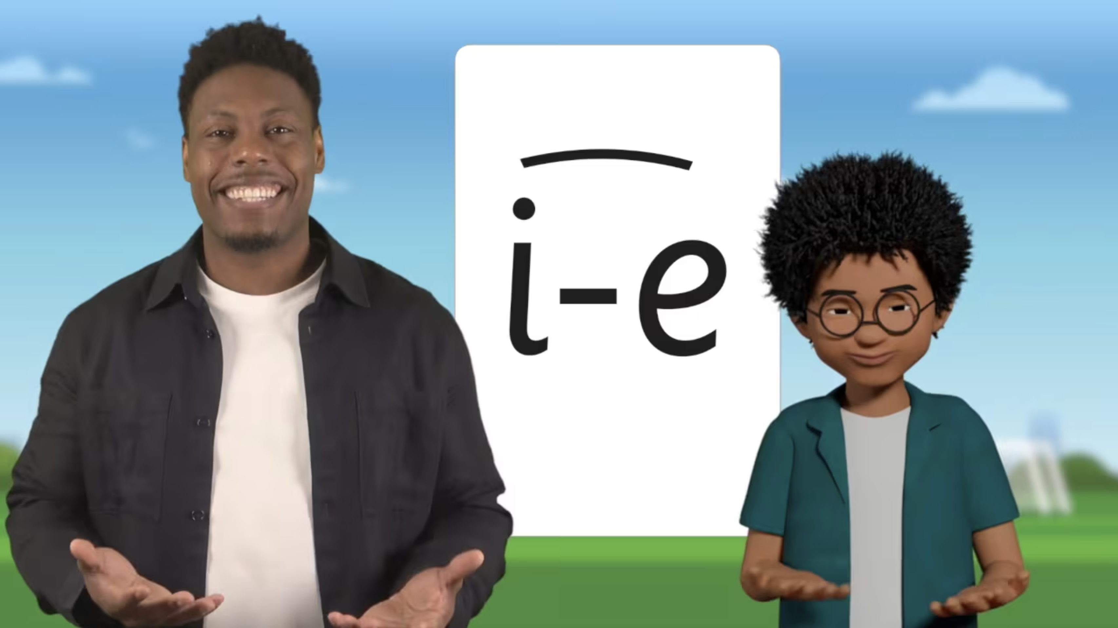
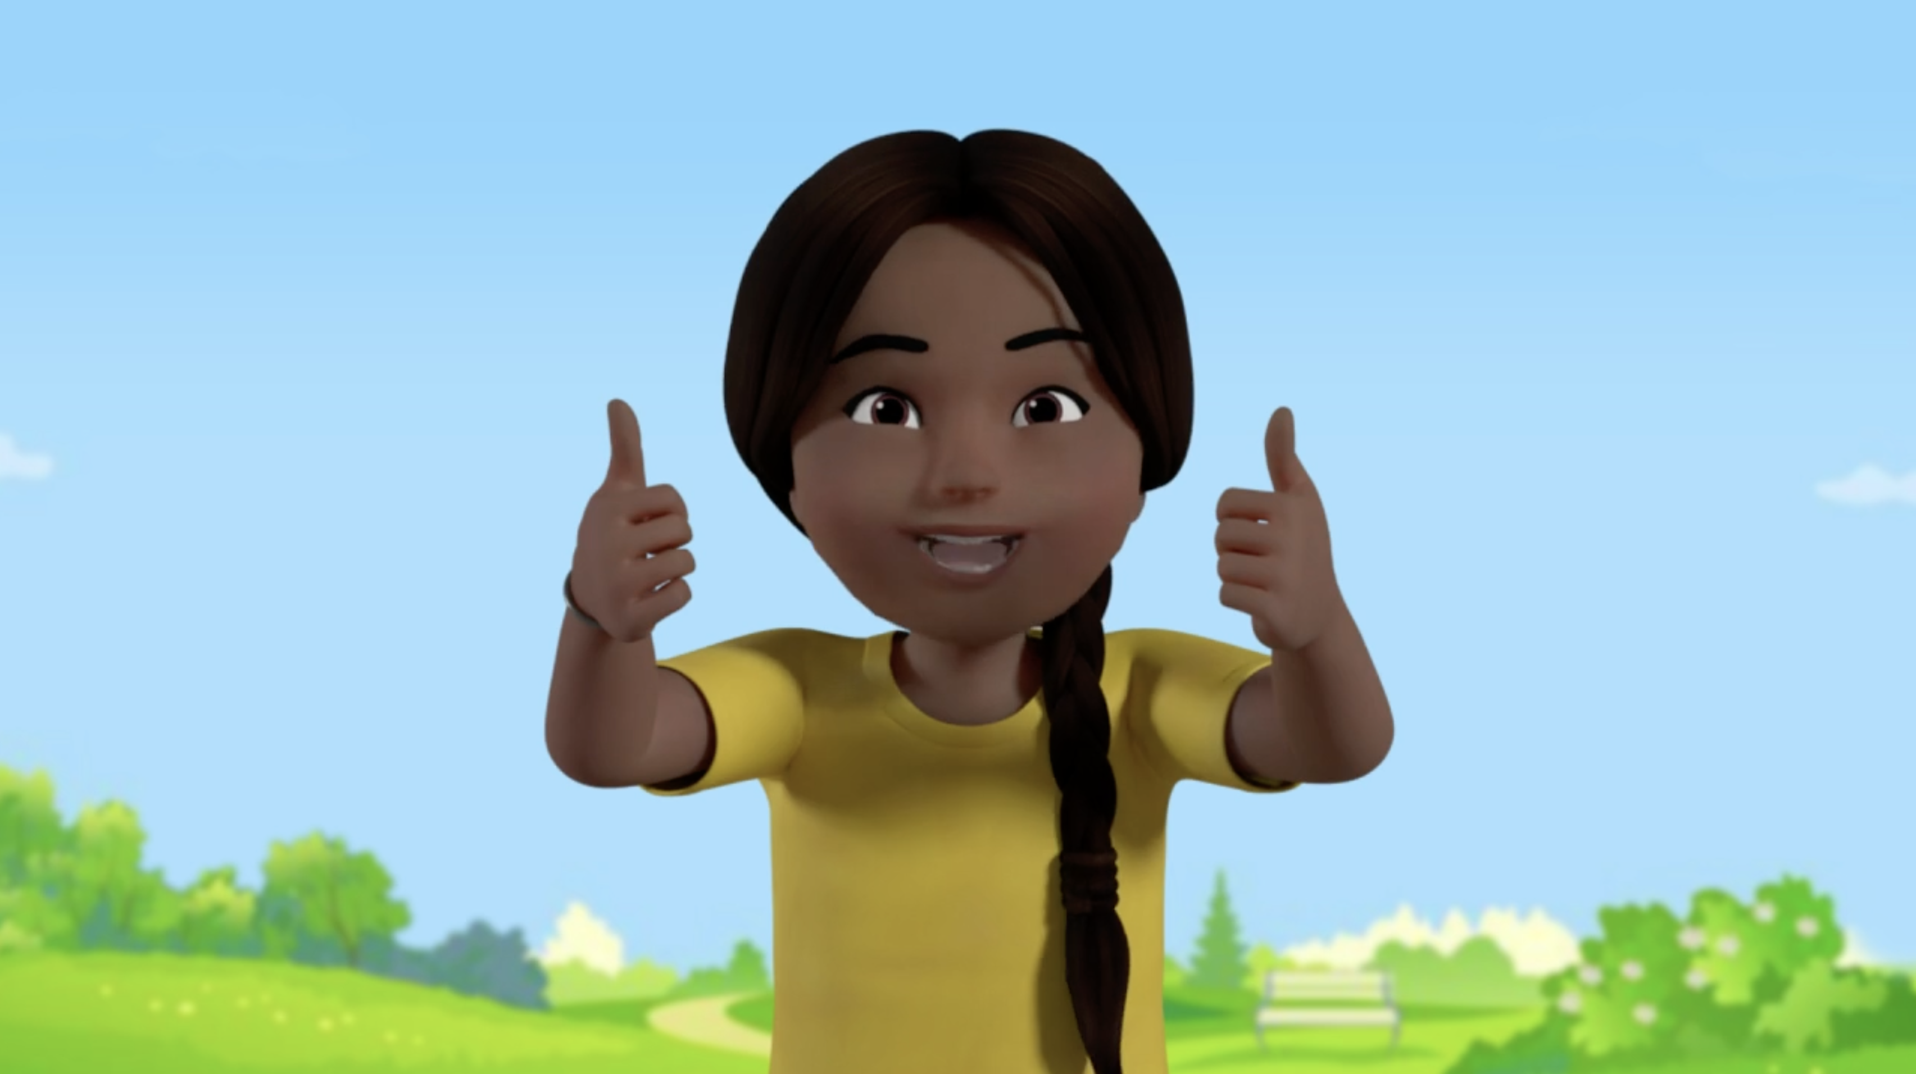
Virtual Classroom films
Notes:
Each week, we will send home film links to lessons that match the sounds and words your child has been learning in school.
Plus 5-minute Word Challenge films.
Your child uses the Virtual Classroom in school.
Children are familiar with the VC teachers and characters – and interact with them as they would their own teacher.
Watch these films with your child to help them to practise reading the sounds and words until they can read them speedily.
The more they practise using these films, the quicker they’ll learn to read.
Simply click the link or scan the QR code and watch on a tablet or other device.
Let’s have a look at one of these films on the Virtual Classroom. Play a Set 2 or 3 Word Challenge film from the virtual classroom.

Slide 10
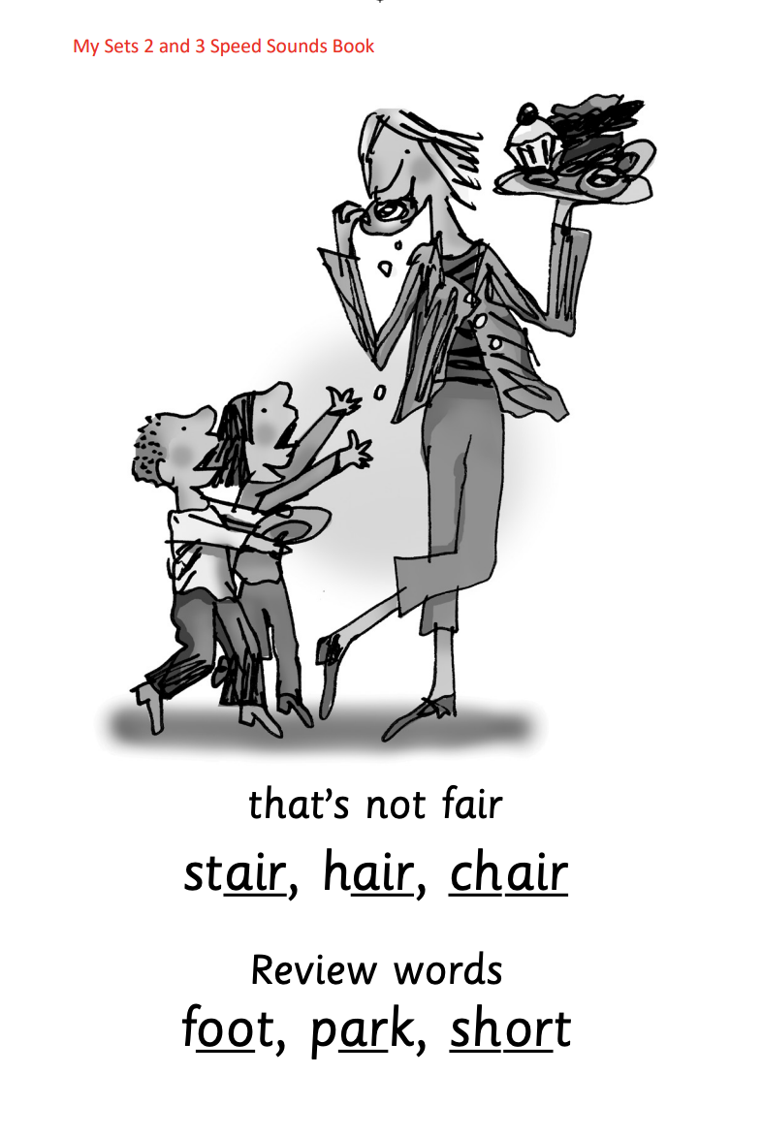





Practice at home
Notes:
Discuss the one that is applicable to your school:
Your child will also bring home a My Set 2 and 3 Speed Sounds books to practise reading and writing the Set 2 and 3 sounds and words.
There are instructions for you inside cover of the book.
Each week, your child will bring home the Speed Sounds cards they have been taught to practise reading sounds speedily.
You can purchase Set 2/3 flashcards or My Reading and Writing Kit ages 5-7 becoming a reader to support your child with Set 2 sounds at home if you wish.

Slide 11
What can I do?
Help your child to use ‘Special Friends’, ‘Fred Talk’ to read words.
Practise reading sounds speedily.
Watch the Virtual Classroom films together.
Listen to your child read their Storybook every day.
Notes:
Help your child to use ‘Special Friends’, ‘Fred Talk’ to read words.
Practise reading sounds speedily.
Watch the Virtual Classroom films together.
Listen to your child read their Storybook every day.

Slide 12
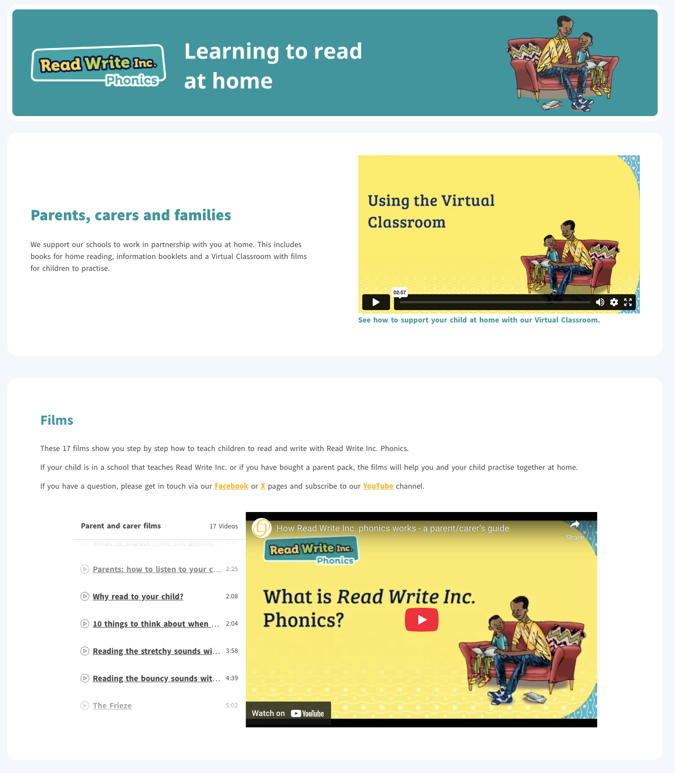
Free Video Tutorials (ruthmiskin.com)
Notes:
Watch these video tutorials on the Ruth Miskin website to find out more about the PSC:
Understanding Phonics
The Phonics Screening Check

Slide 13
Online resources available
Ruth Miskin Families Page:
https://www.ruthmiskin.com/parentsandcarers/
Ruth Miskin Facebook:
https://www.facebook.com/miskin.education
Free e-books for home reading:
http://www.oxfordowl.co.uk/Reading/

Slide 14
Reading changes everything
Teach a child to read and keep that child reading and we will change everything.
And I mean everything.
Jeanette Winterson
Notes:
Remember that all parents have the power to change outcomes for their children.

Slide 15

Any questions?

